Slide 1
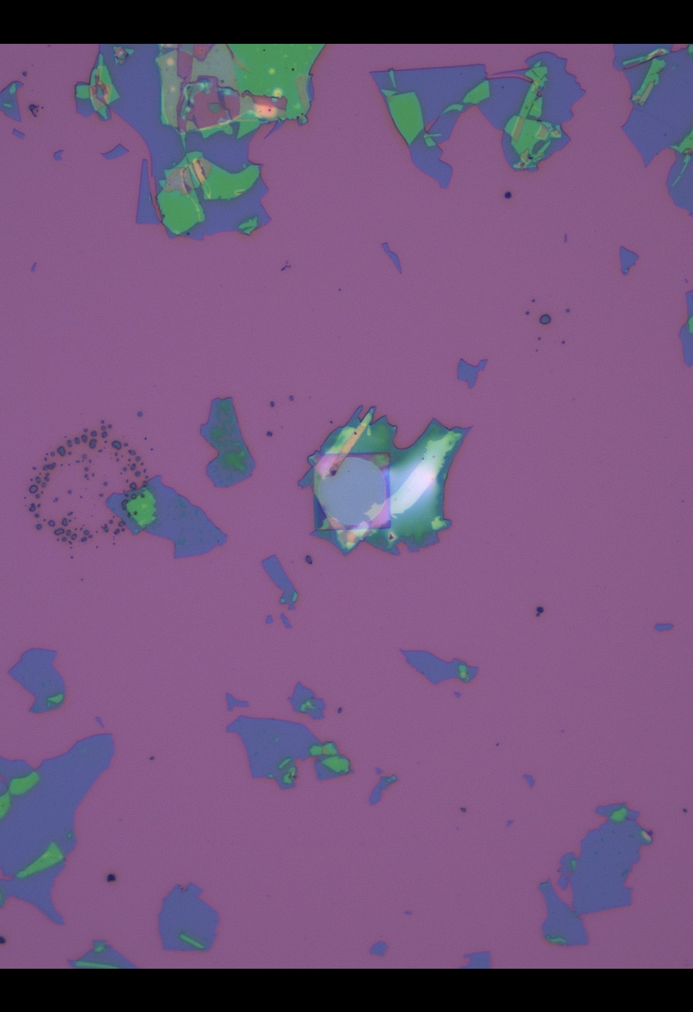

Slide 2
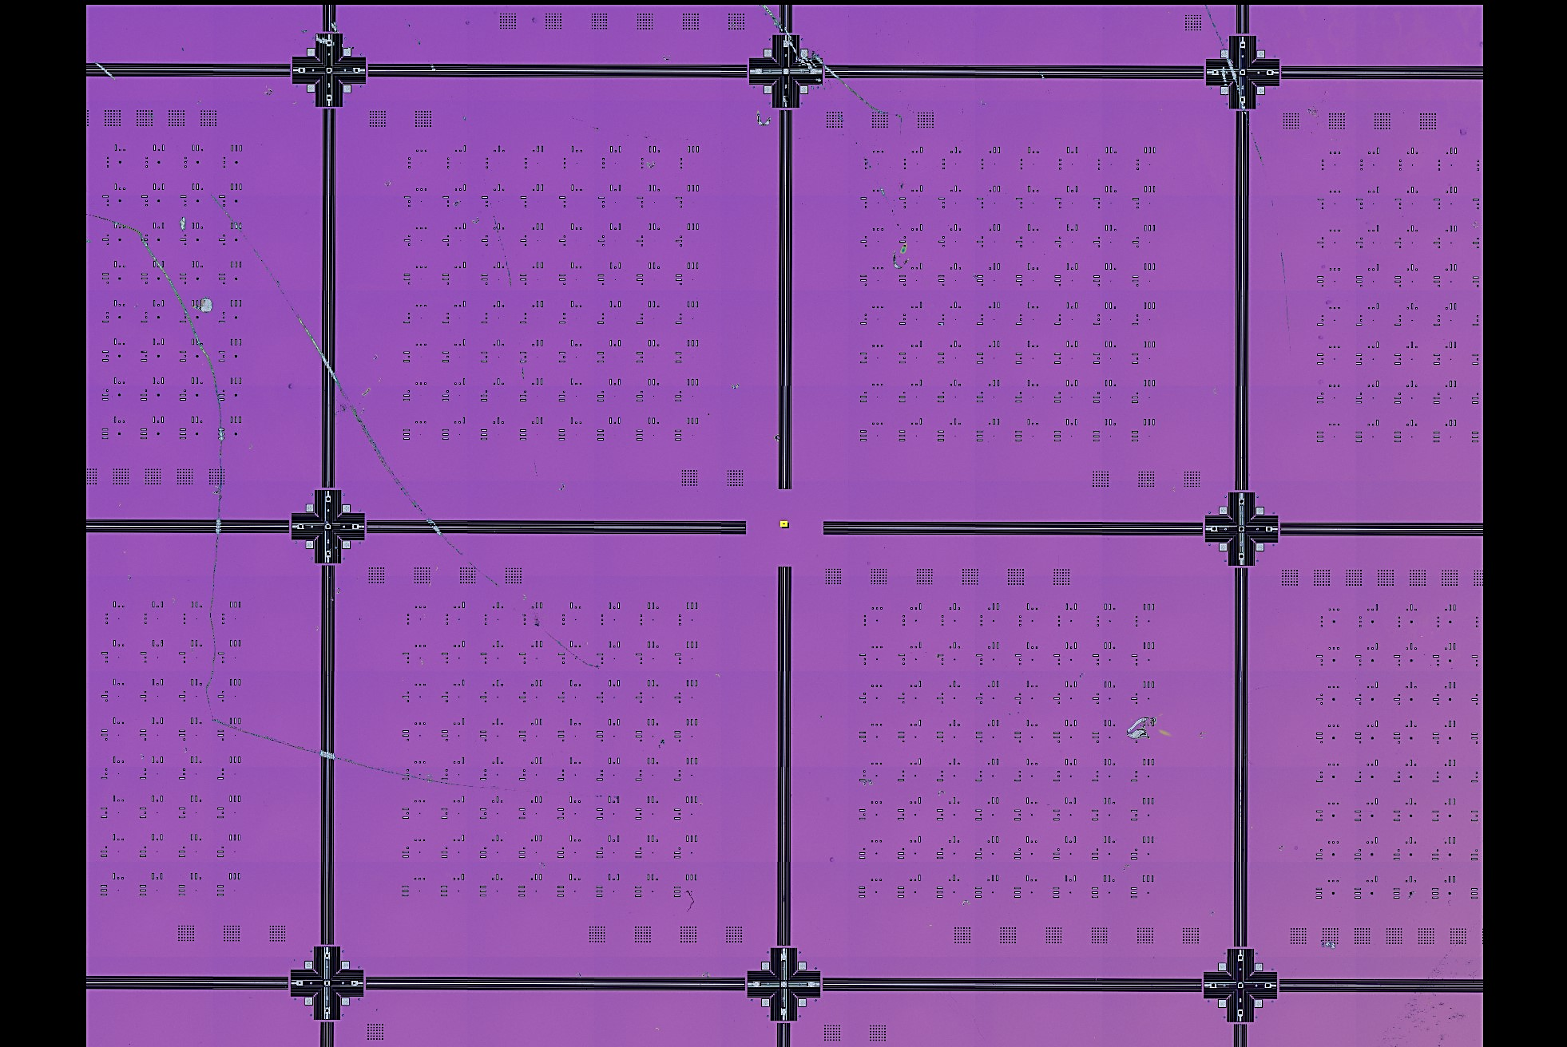
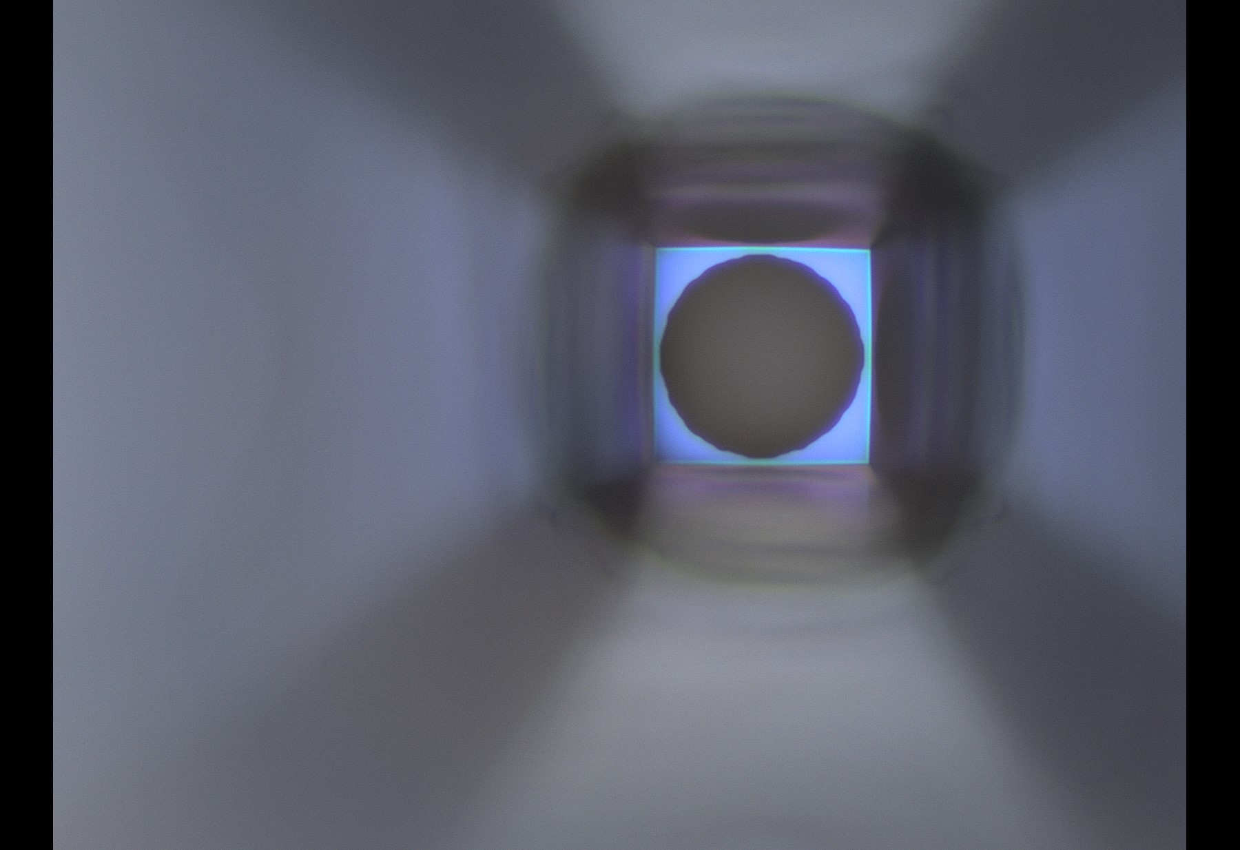
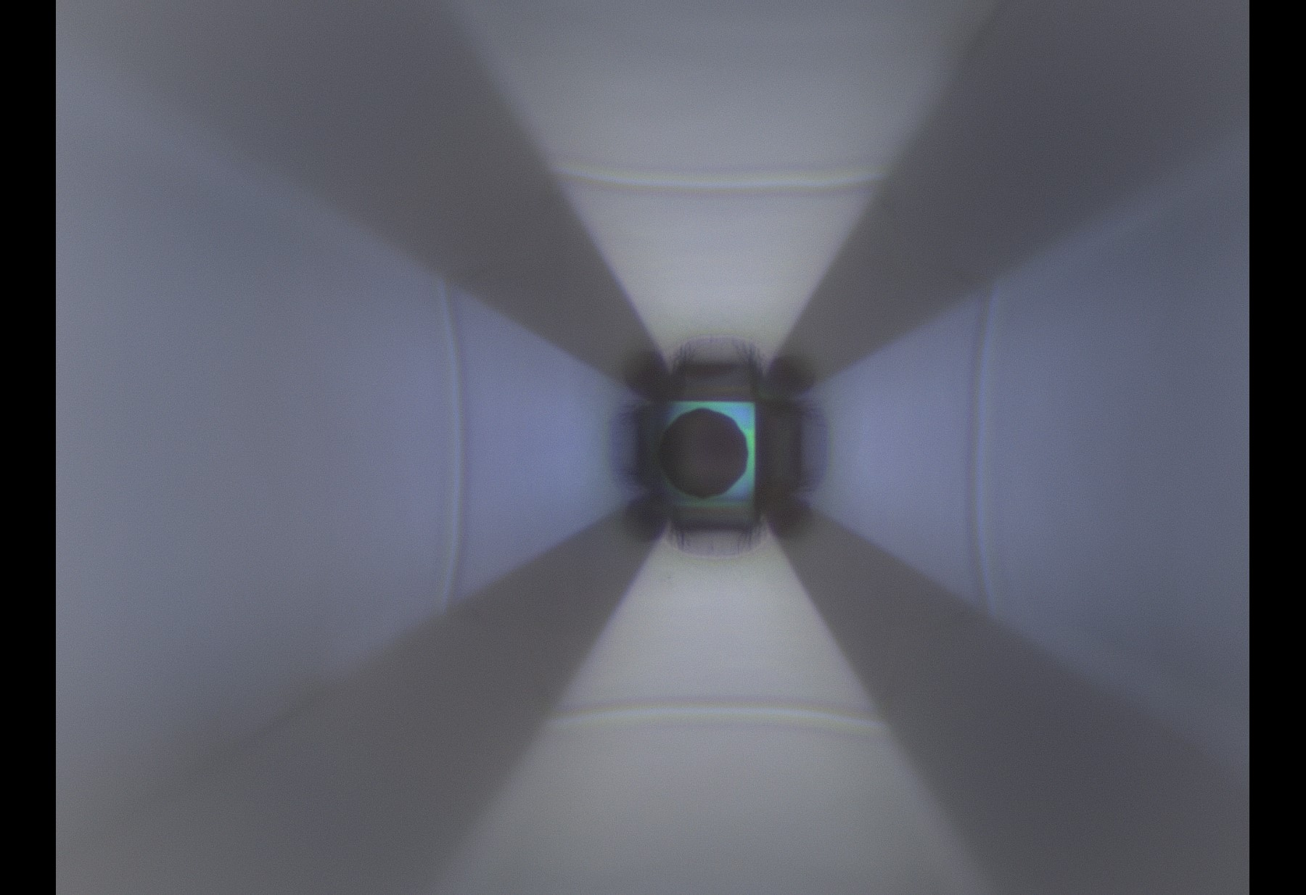
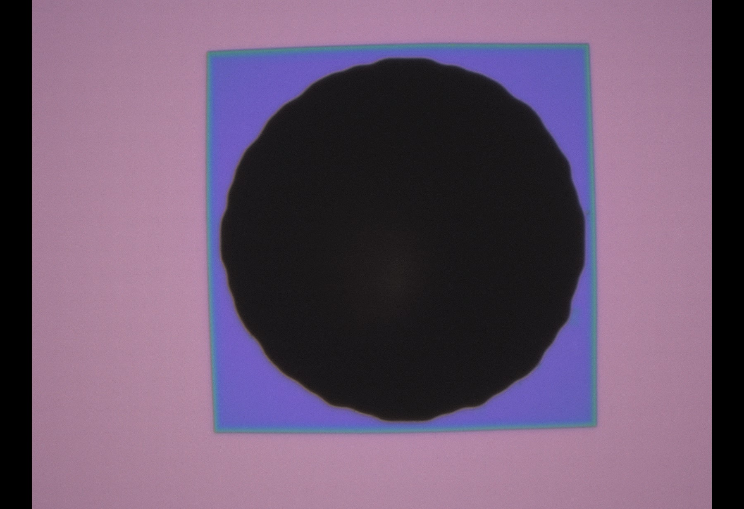
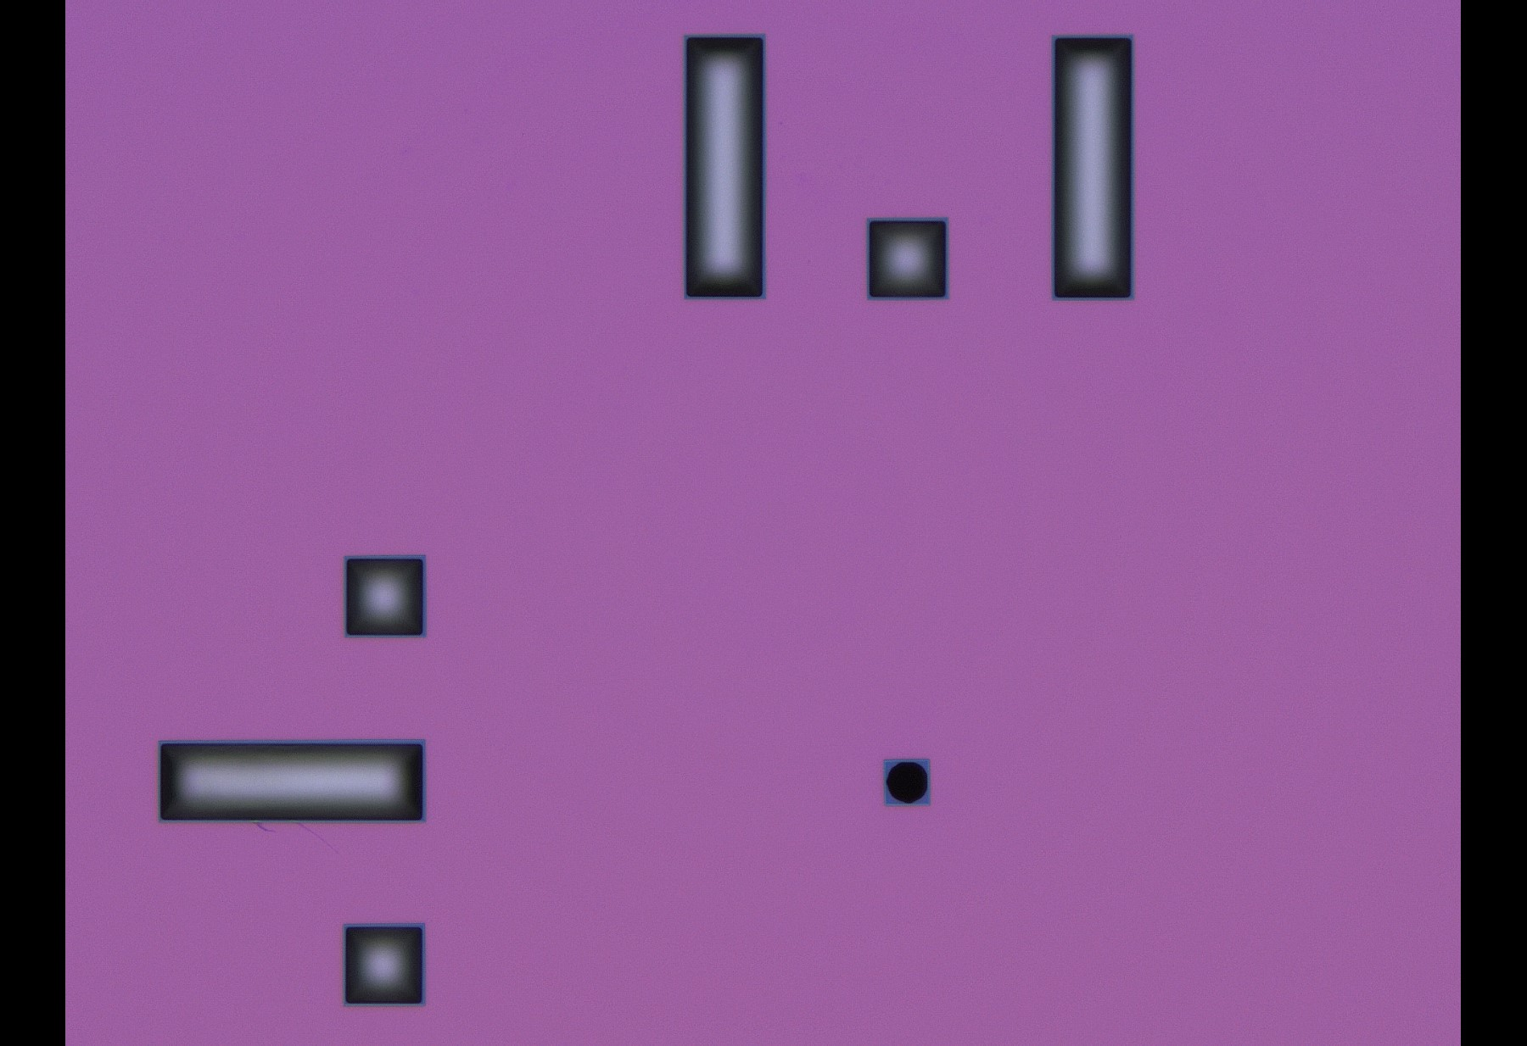
Holey SiNx 02
Hole size indicator of the chip Size = N matrix of squares x 5 [um]
This example: Nominal size is 15 (3x5) [um]
Backside C10 (50 um)
Backside C8 (20 um)
SiNx surface over Si
1
2
3
4
5
6
7
8
SiNx
Topside C10 (50 um)
Row and column index in binary
So they start at zero (just add 1)
Square: 0
Rectangle: 1
This example:
Row: [2]+1 (010)
Colum: [5]+1 (101)
1 2 3 4 5 6 7 8
SiNx

Slide 3
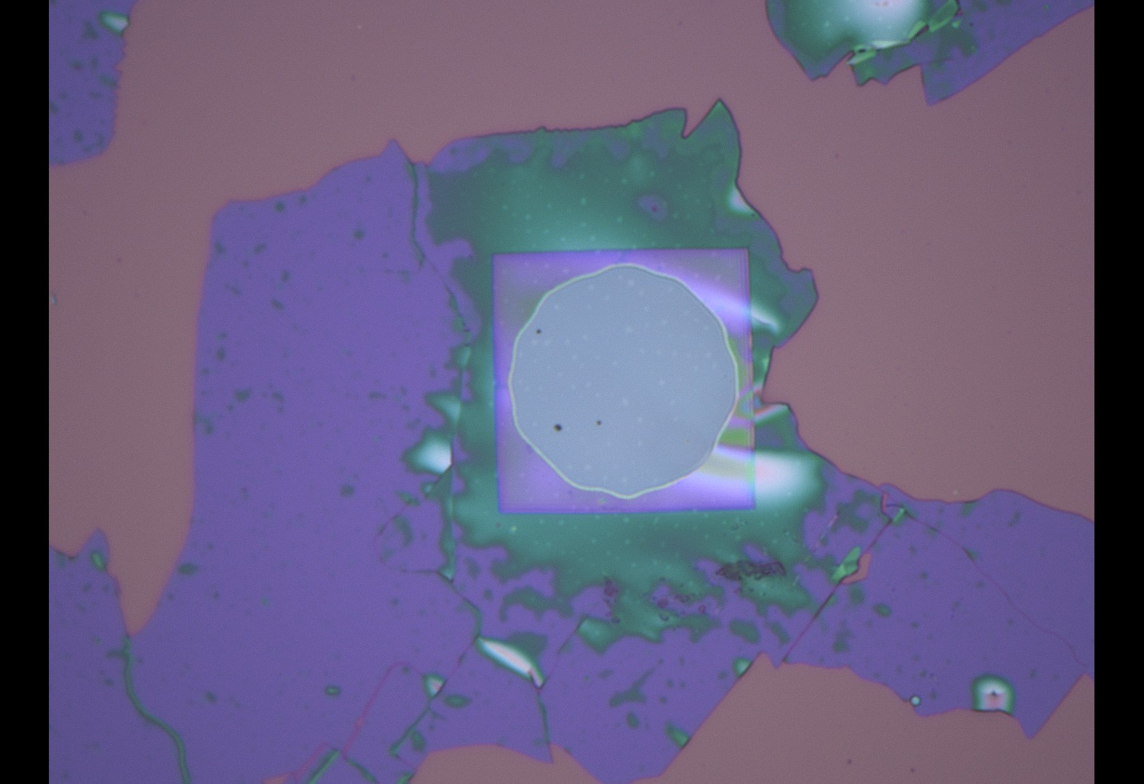
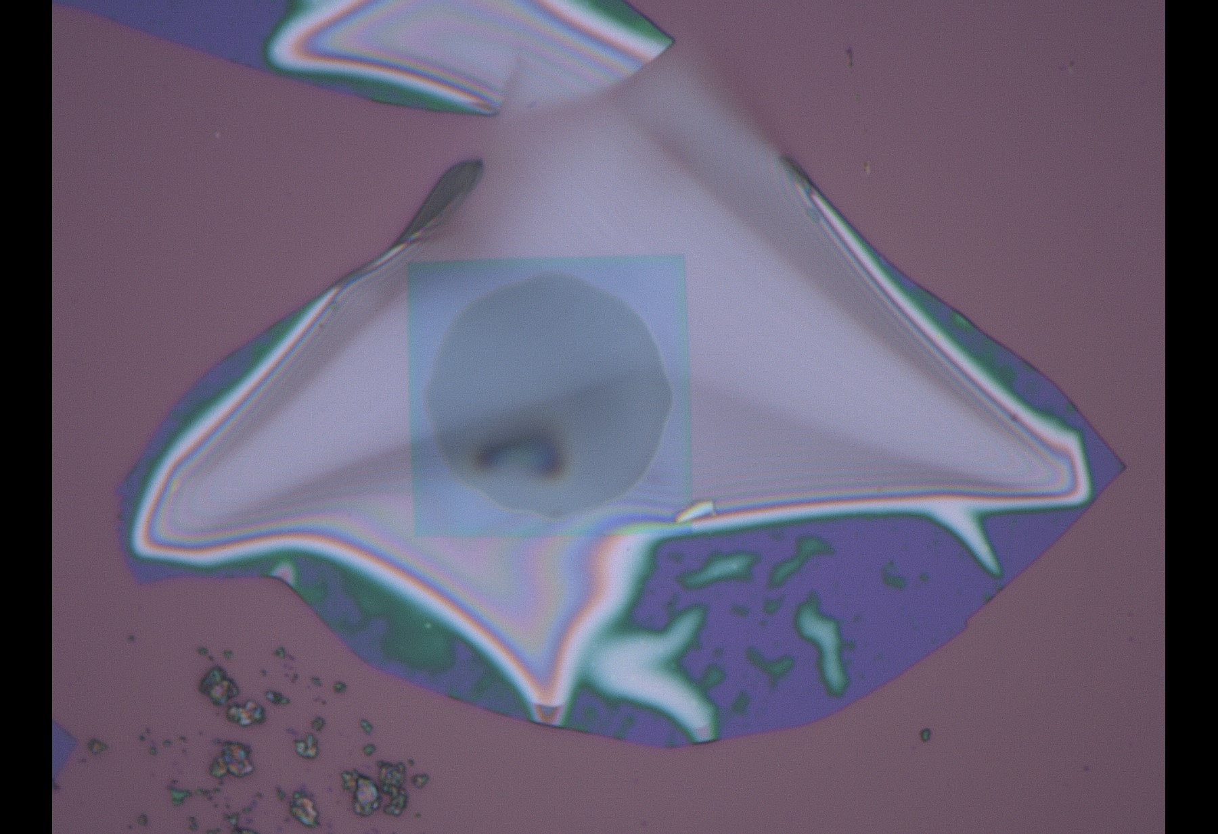
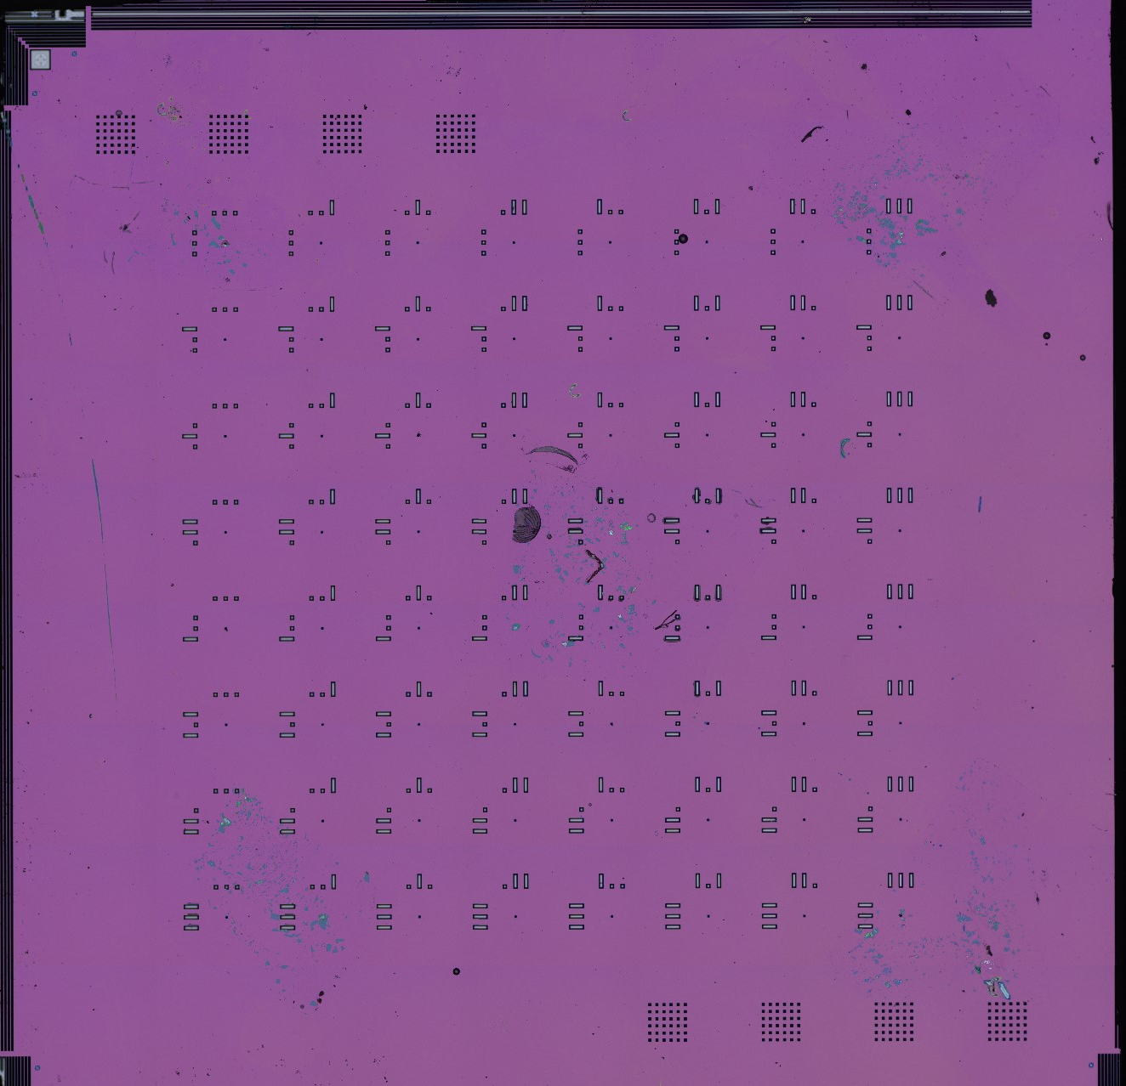
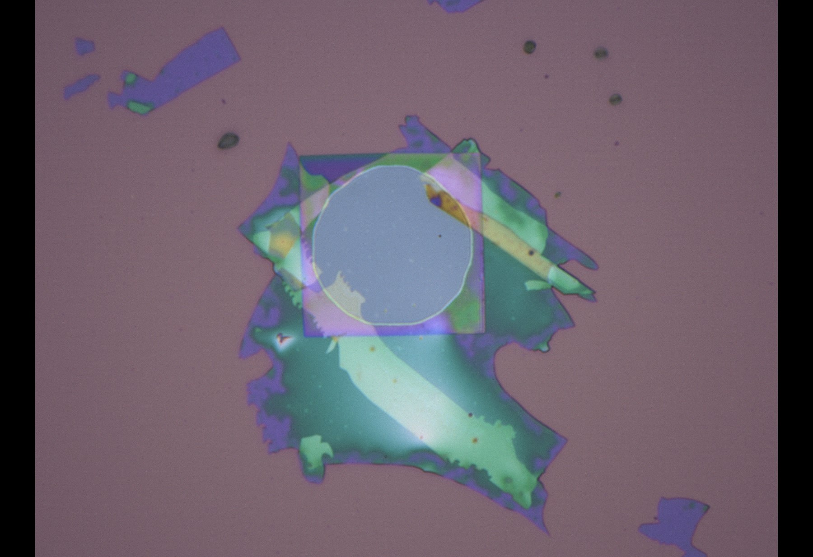
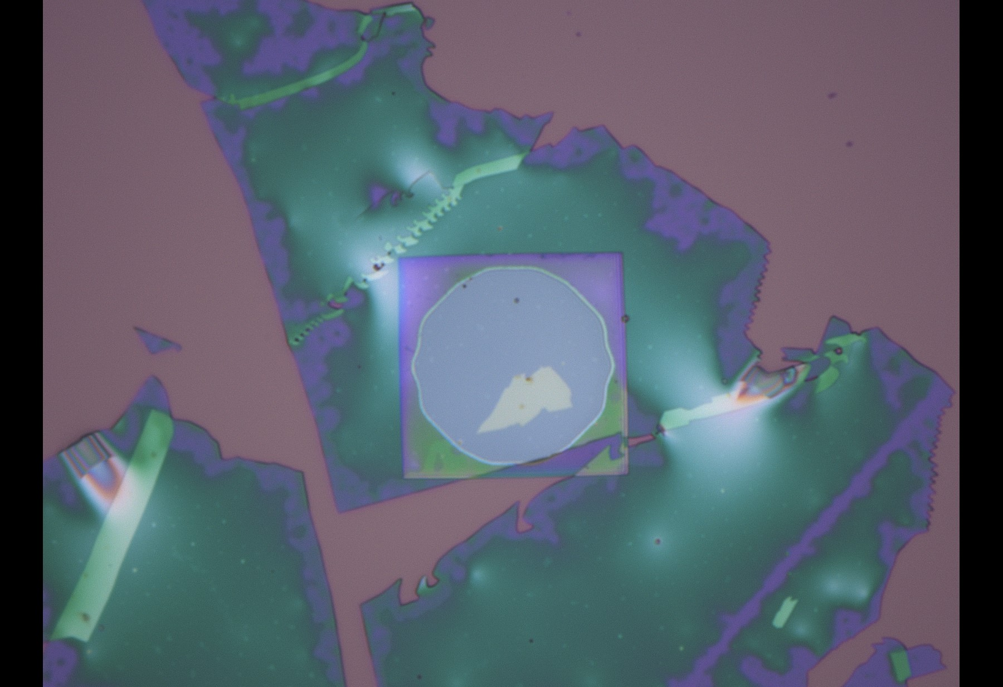
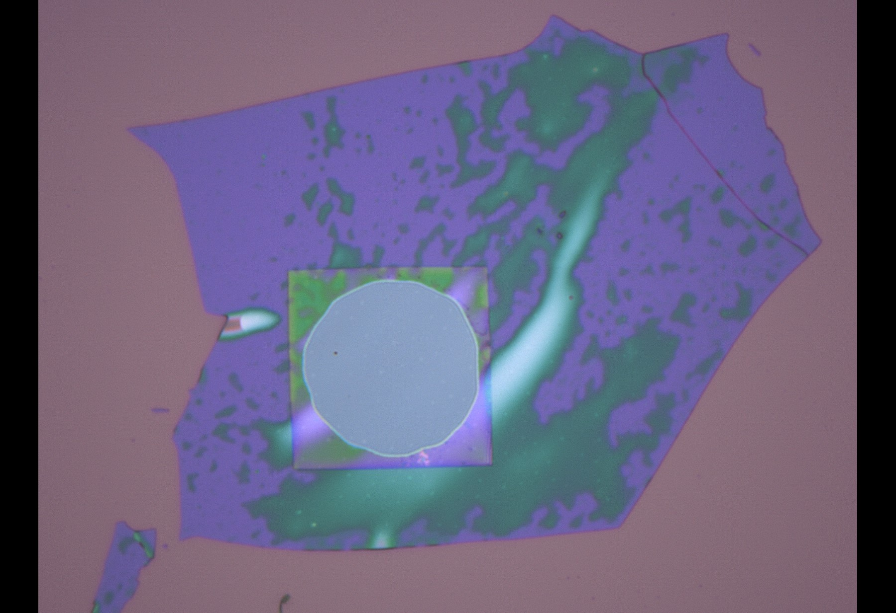
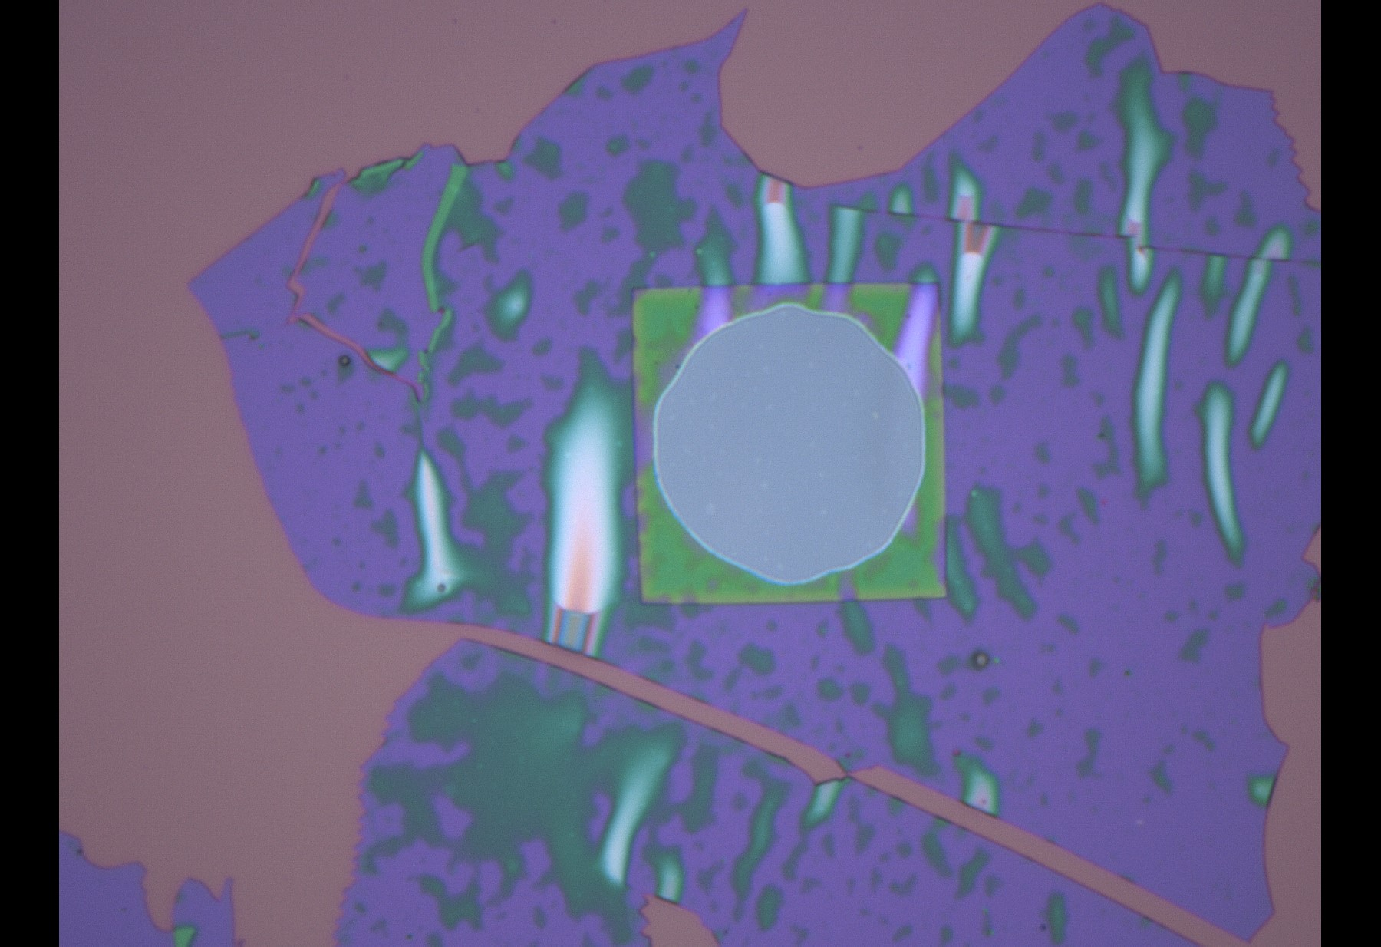
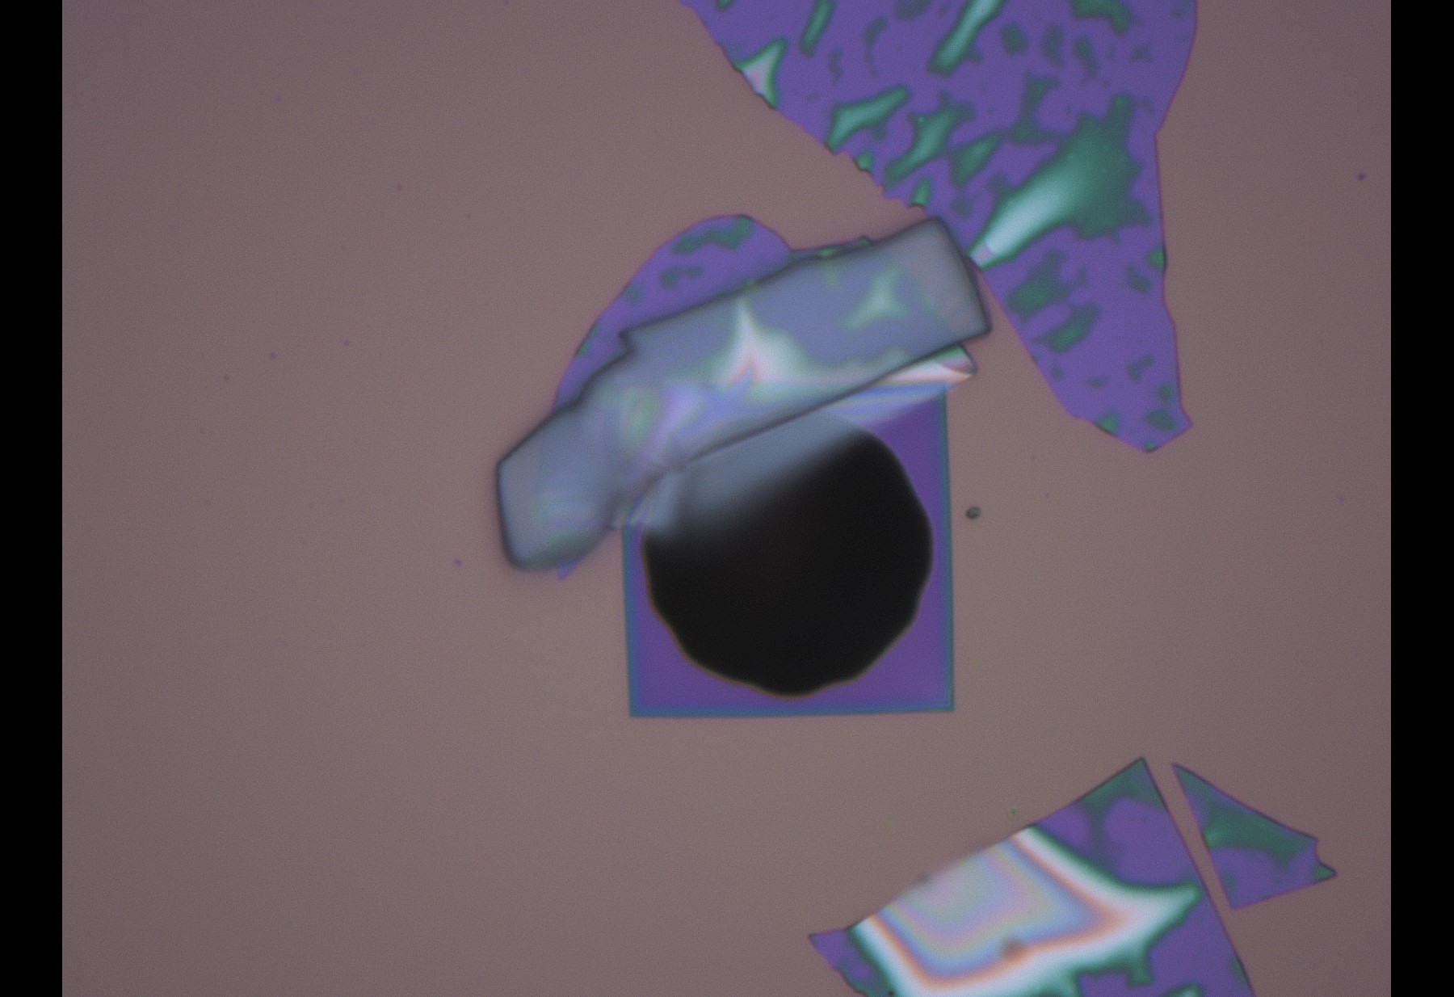
Holey SiNx 02: after PC removal
1-8
1-1
20 um
4-5
20 um
20 um
7-1
5-4
20 um
20 um
8-2
8-8
HSiNx02 C06 (20 um)
20 um
20 um

Slide 4
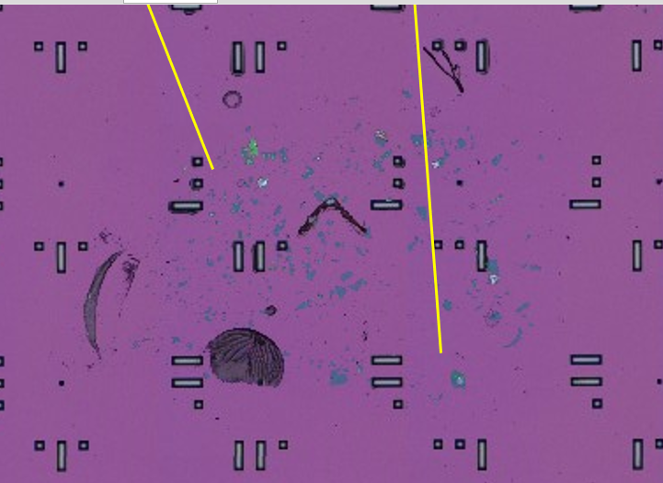
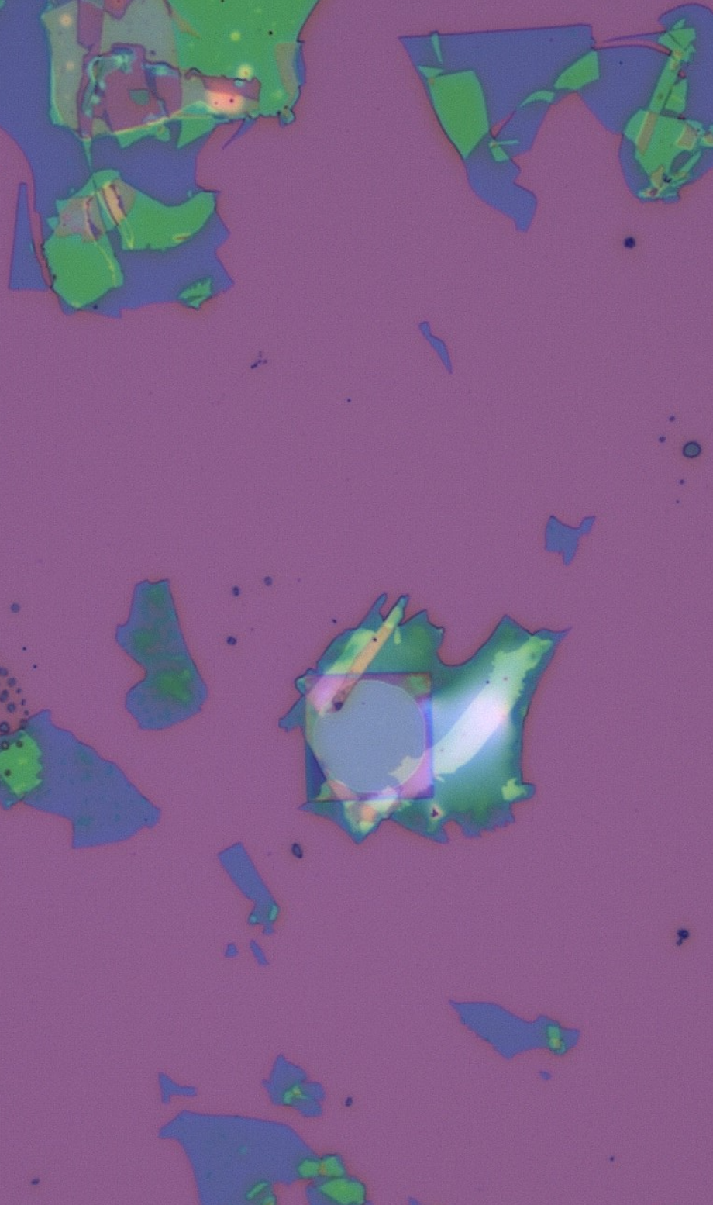

Slide 5
Measurements 27.02.2025 thermooptosetup

Slide 6
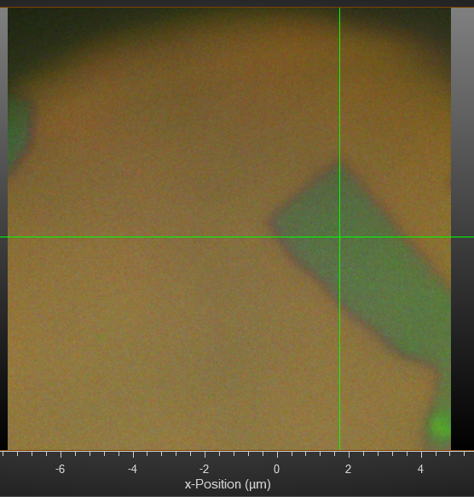

Slide 7
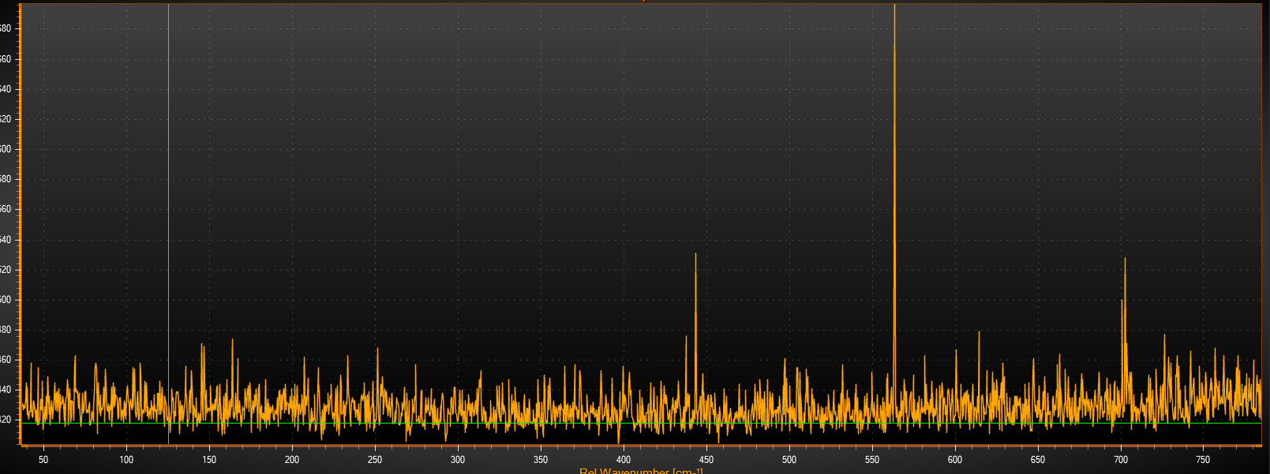
Reference at Power 75 uW, 100x1

Slide 8
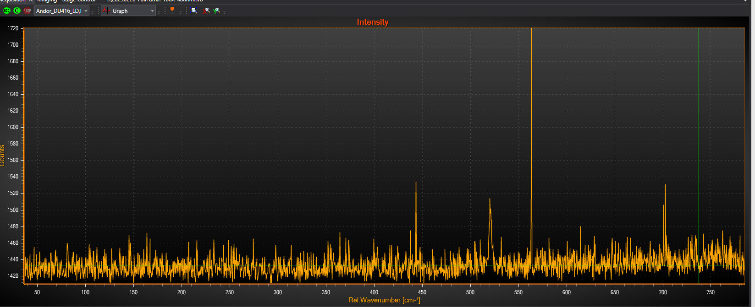
Power 25 uW, 100x1

Slide 9
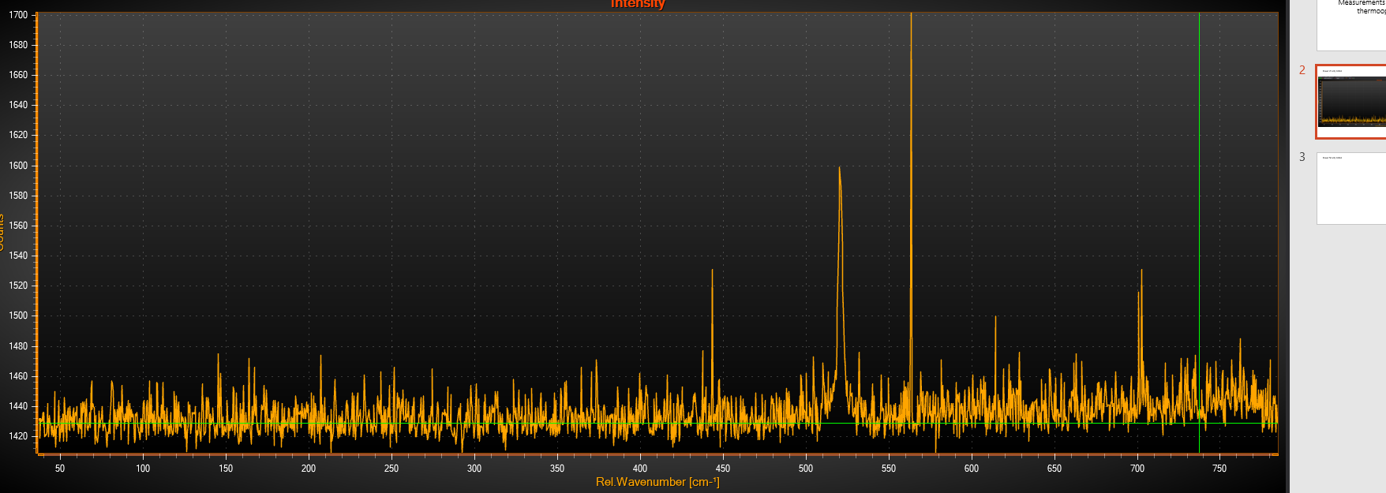
Power 50 uW, 100x1

Slide 10
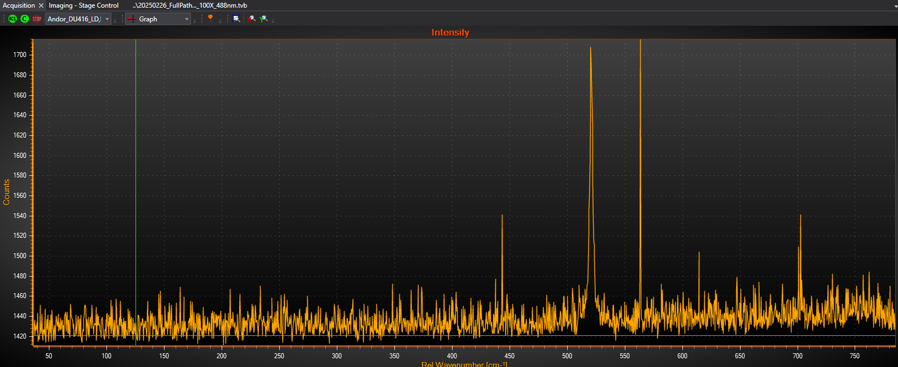
Power 75 uW, 100x1

Slide 11
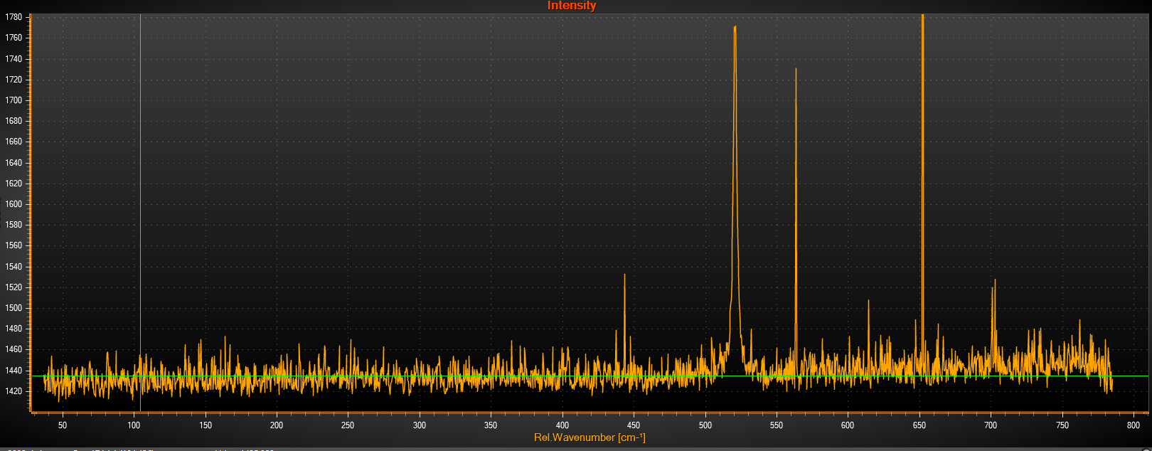
Power 100 uW, 100x1

Slide 12
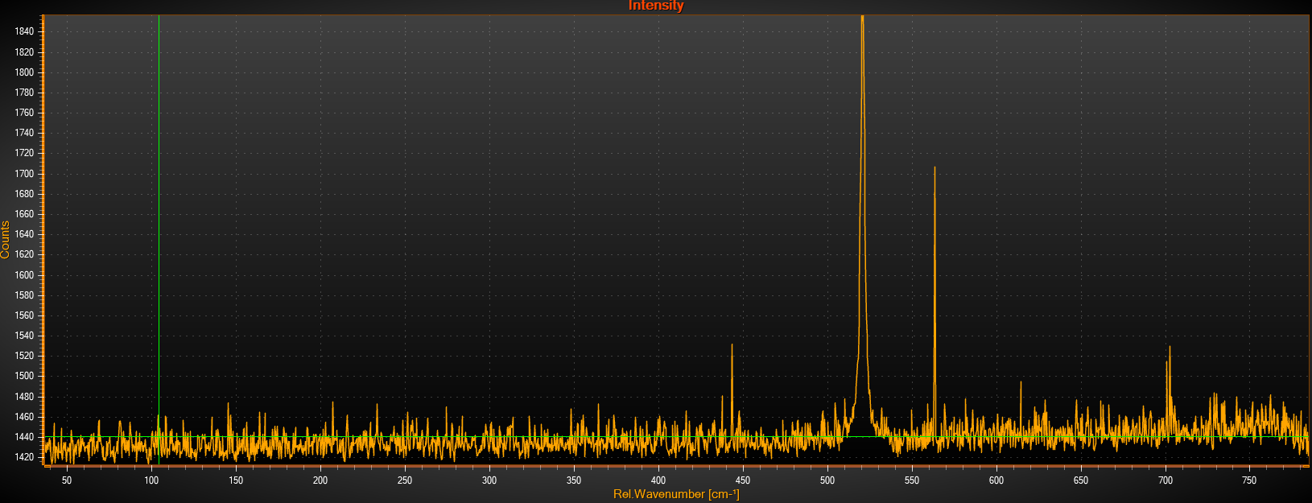
Power 125 uW, 100x1

Slide 13
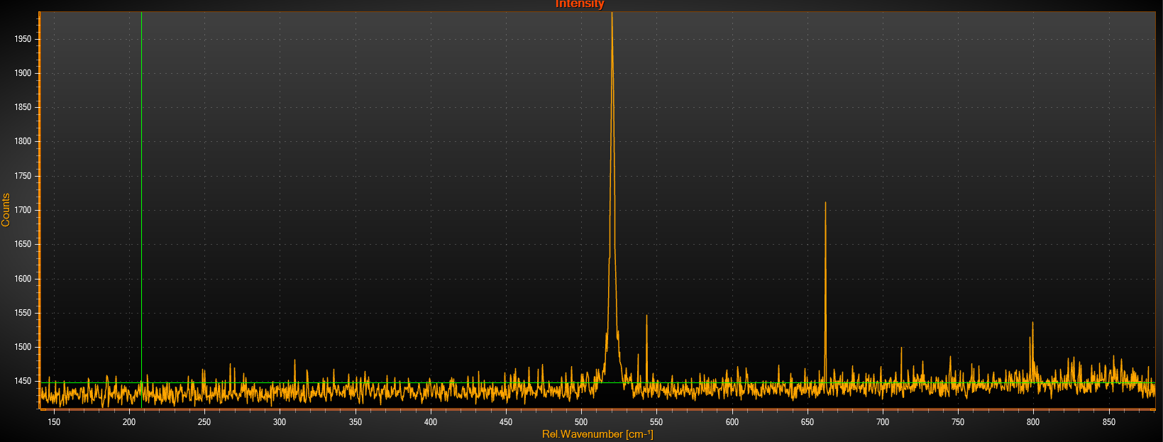
Power 150 uW, 100x1

Slide 14
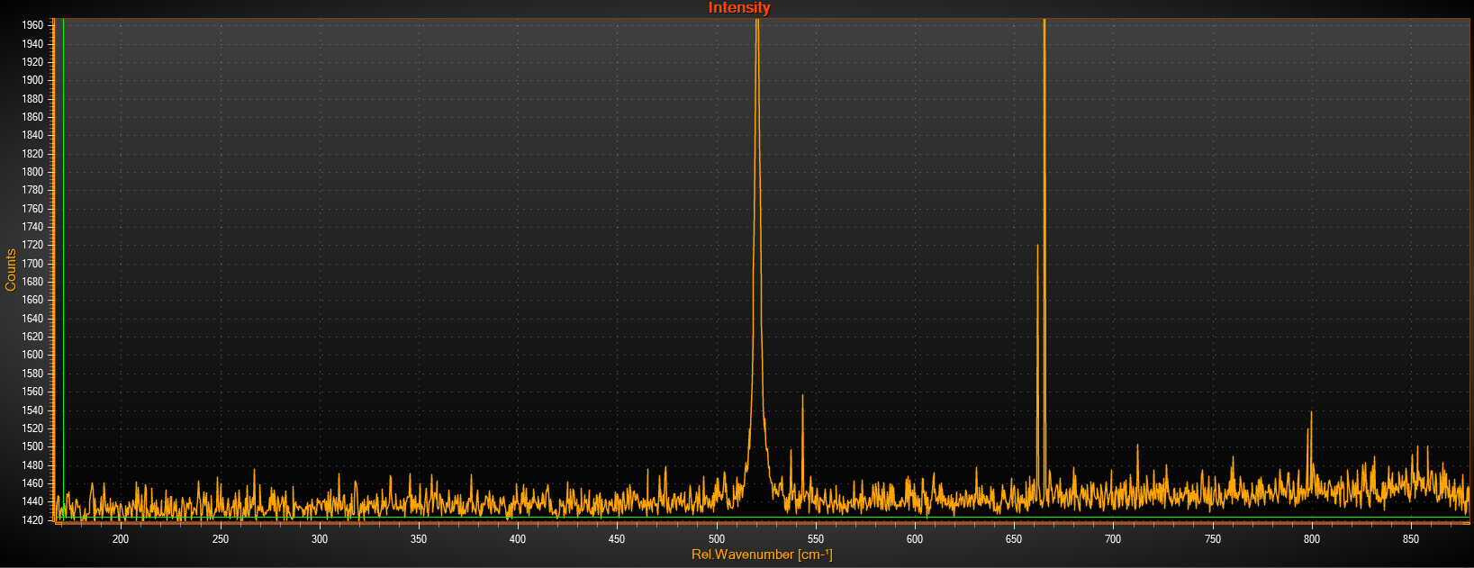
Power 175 uW, 100x1

Slide 15
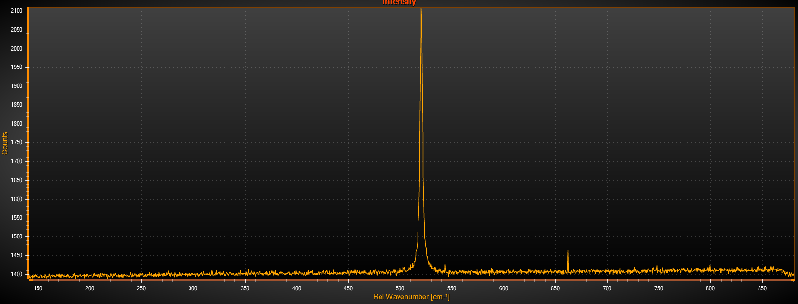
Power 1 mW, 20x1

Slide 16
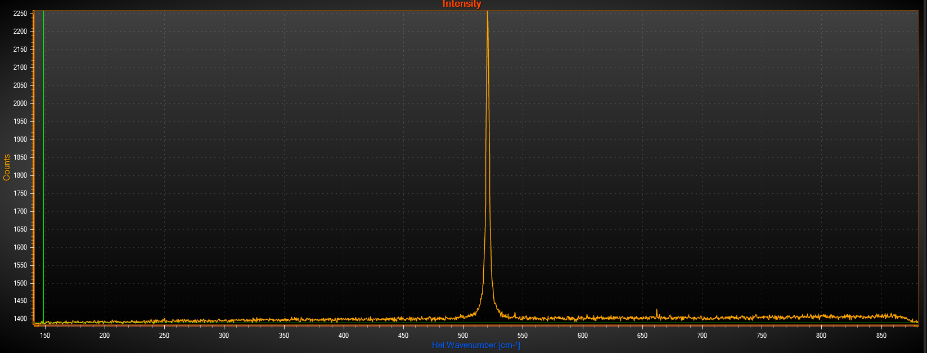
Power 2.5 mW, 10x1

Slide 17
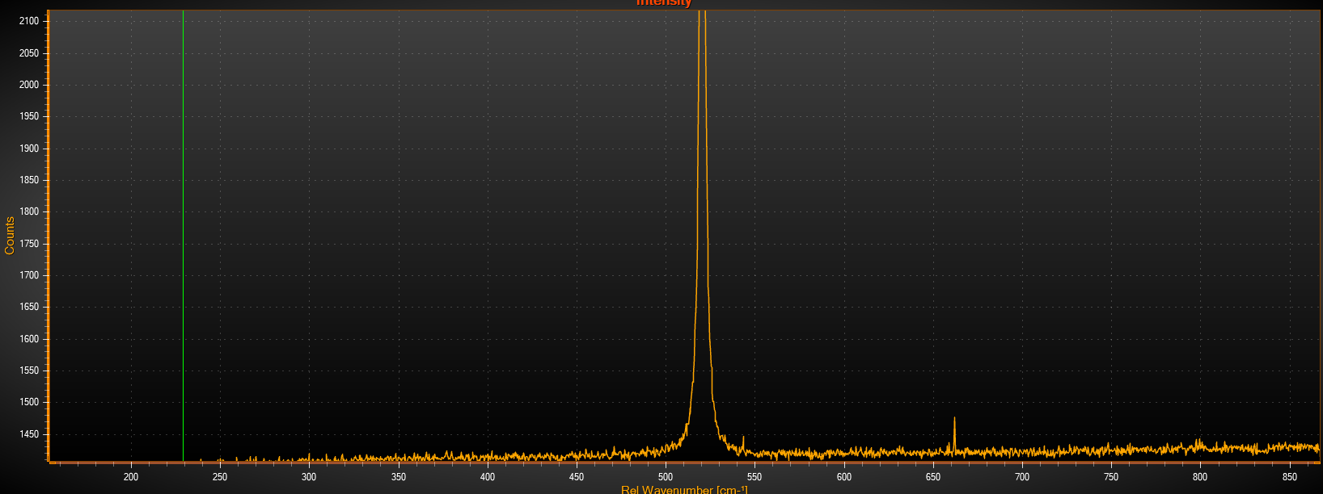
Power 2.5 mW, 20x1

Slide 18
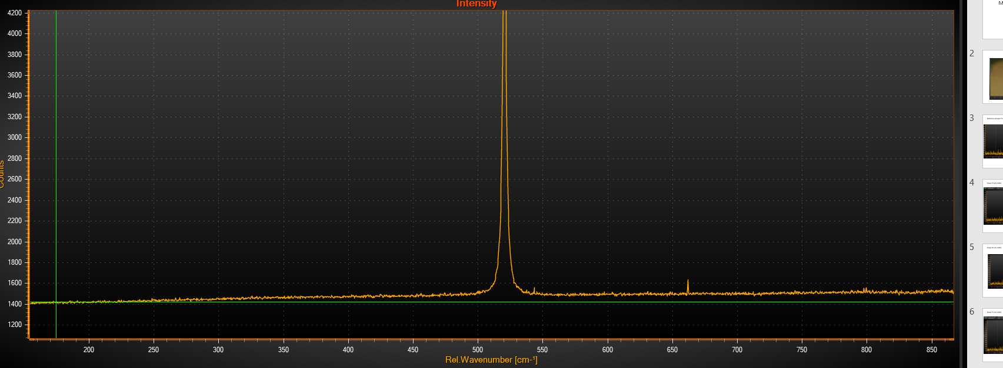
Power 2.5 mW, 50x1

Slide 19
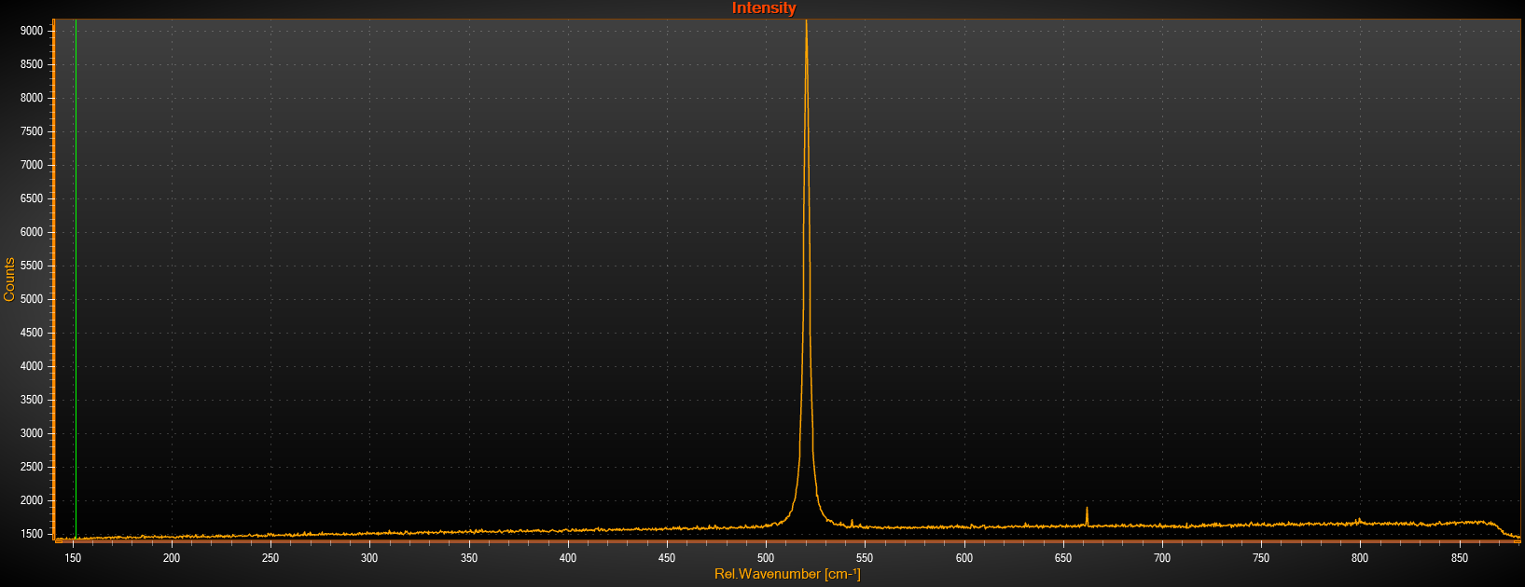
Power 2.5 mW, 100x1, different focus

Slide 20
Polarization changed to 90 90 90
(45 90 45)

Slide 21
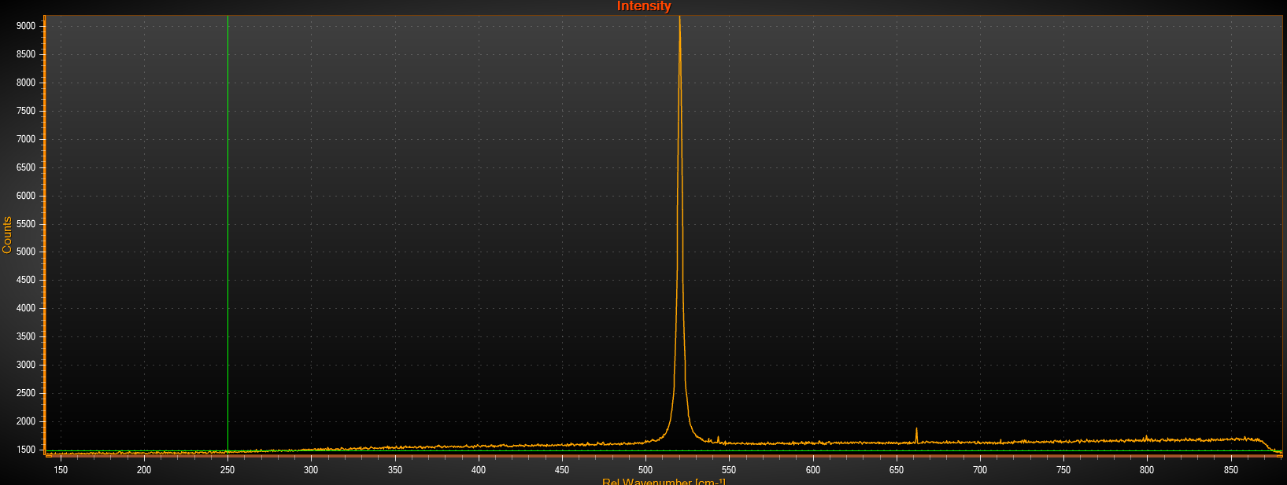
Power 2.5 mW, 100x1, normal focus

Slide 22
Polarization changed to 0 90 90
(0 90 45)

Slide 23
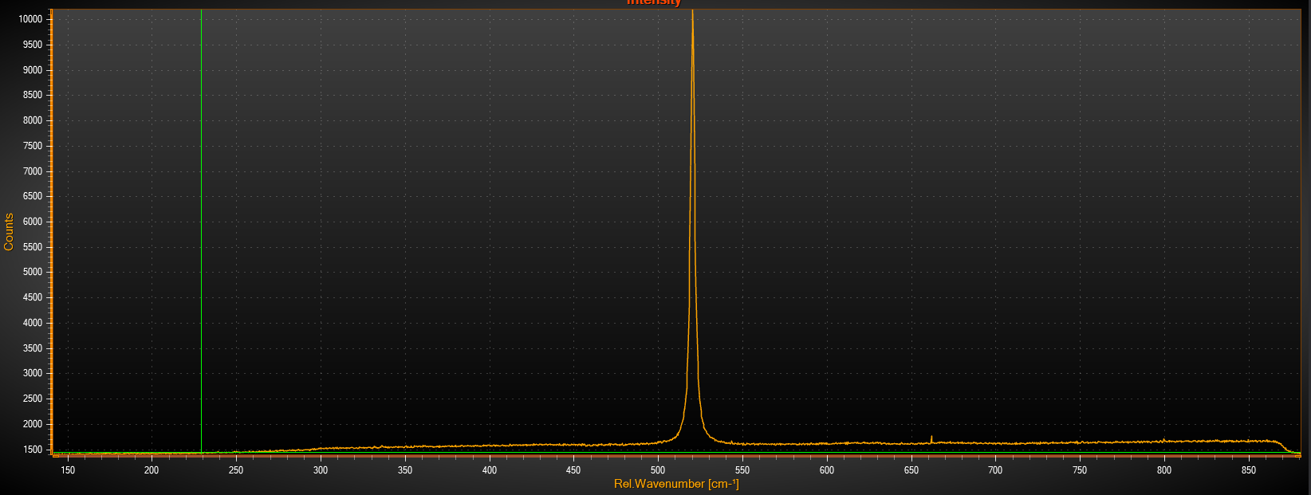
Power 2.5 mW, 100x1, normal focus

Slide 24
Polarization changed to 90 0 0
(45 0 0)

Slide 25
Power 2.5 mW, 100x1, normal focus

Slide 26
28.02.
Plan new big flake

Slide 27
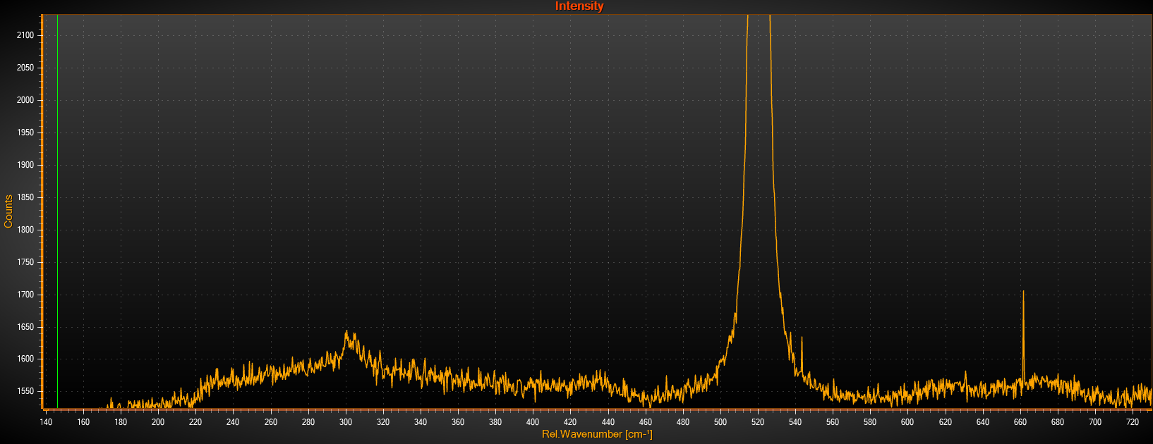
Power 2.5 mW, 50x1, focus, 90 0 0 polarization

Slide 28
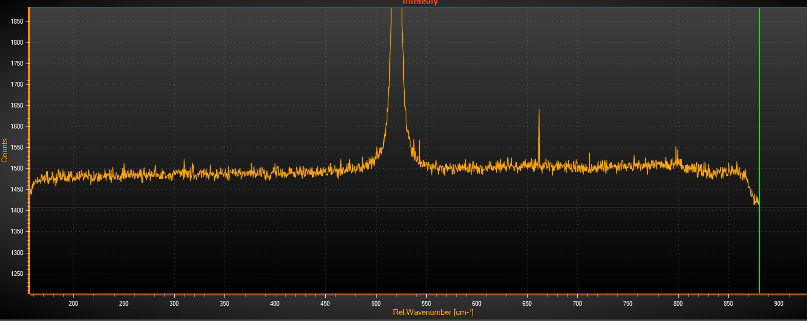
Power 2.5 mW, 50x1, focus, 0 0 0 polarization

Slide 29
Change focus, see signal at two polarizations
new big flake

Slide 30
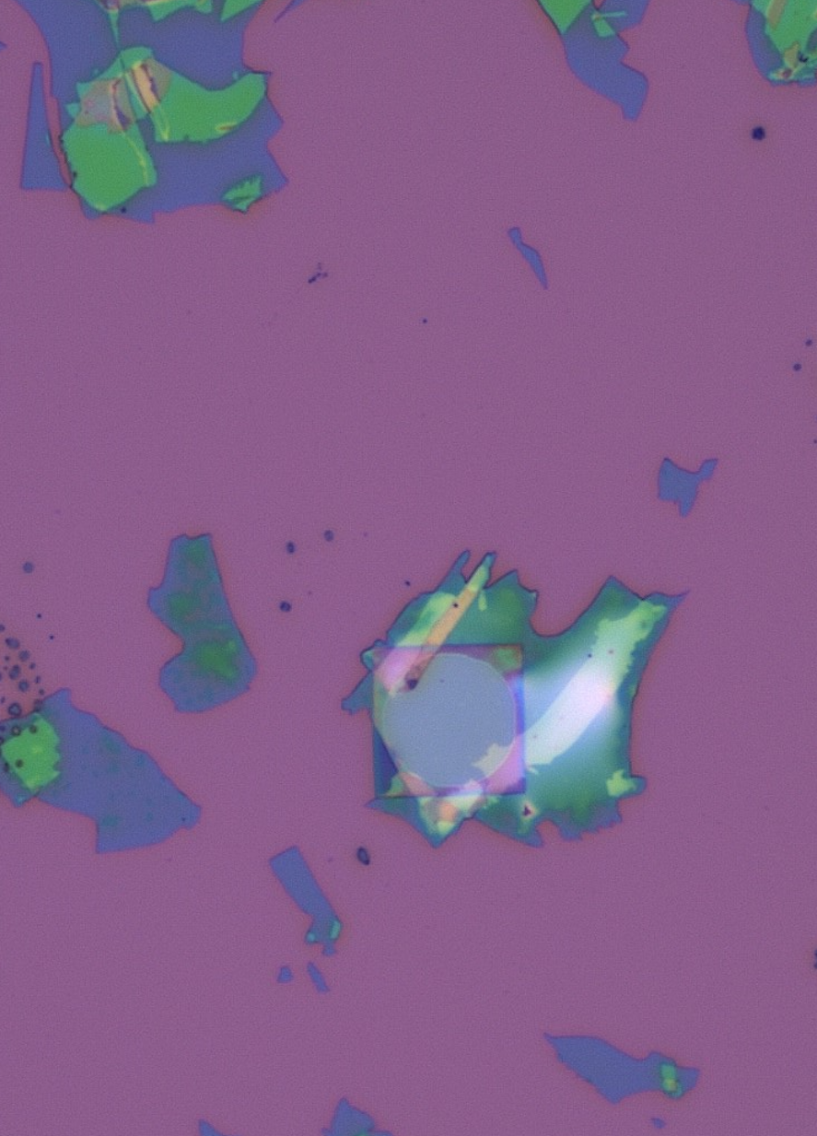
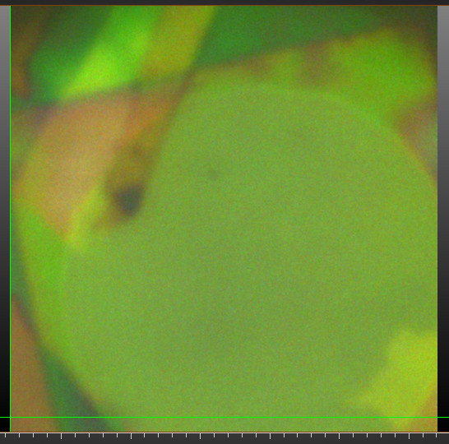

Slide 31
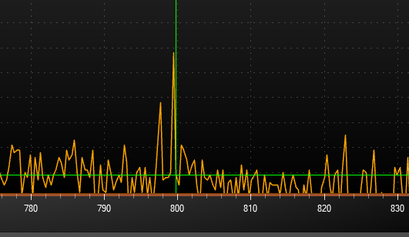
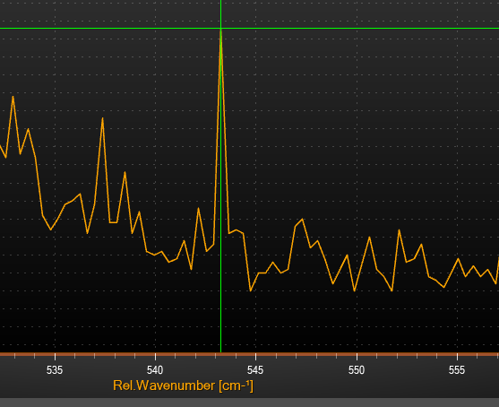
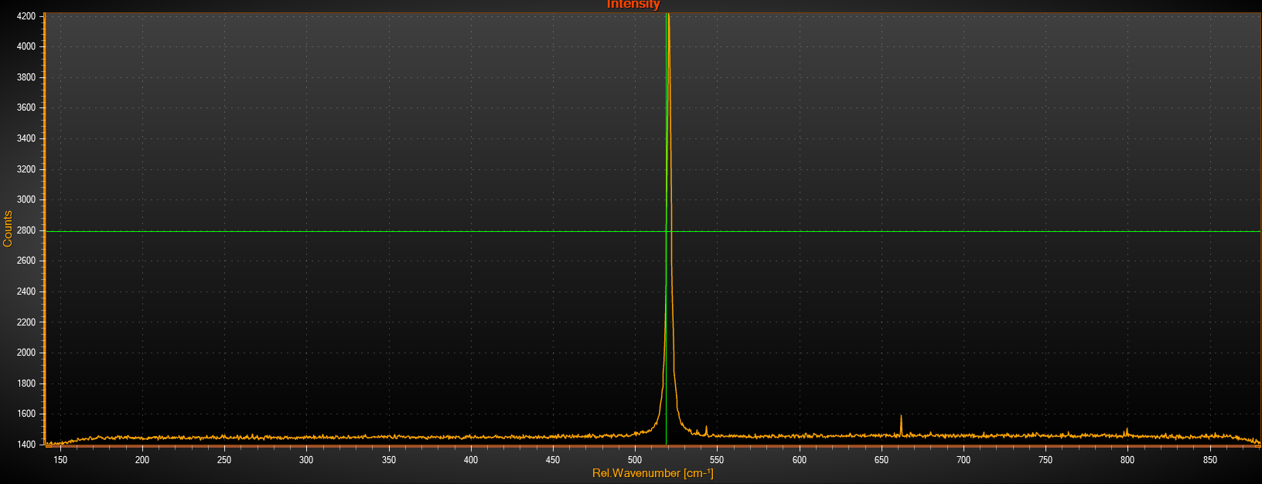
Power 2.5 mW, 50x1, focus, 0 0 0 polarization

Slide 32
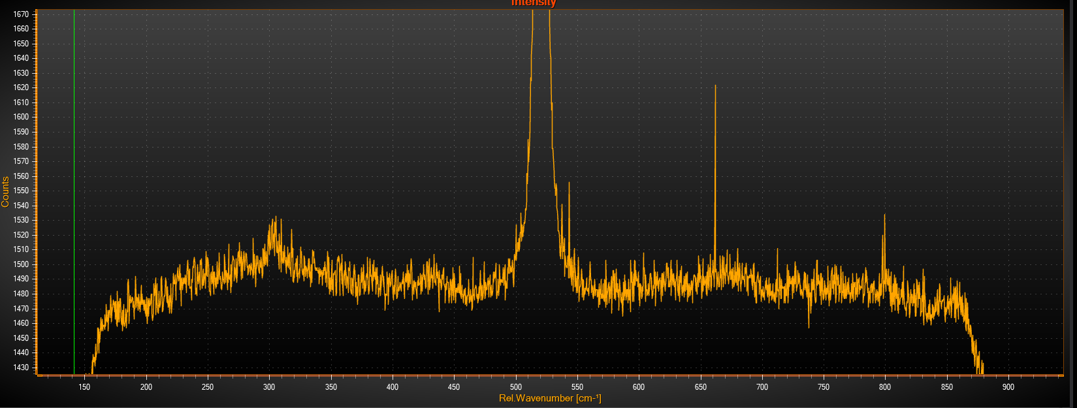
Power 2.5 mW, 50x1, focus, 90 0 0 polarization

Slide 33
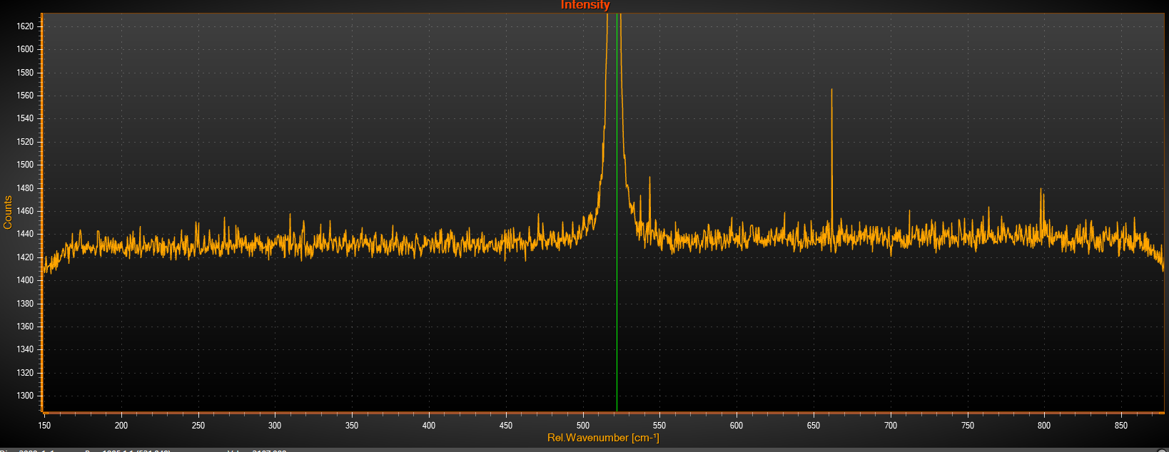
Power 2.5 mW, 50x1, focus, 90 90 90 polarization

Slide 34
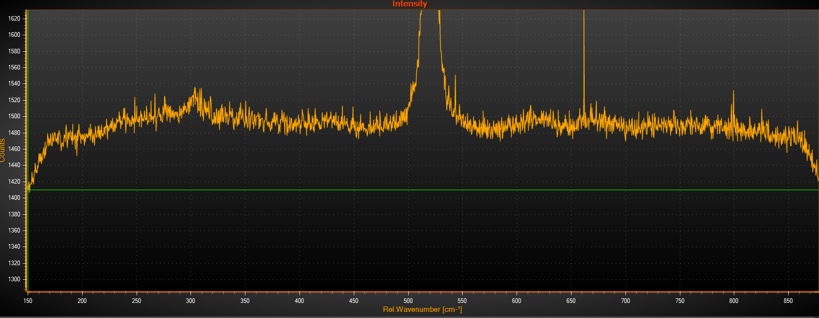
Power 2.5 mW, 50x1, focus, 0 90 90 polarization

Slide 35
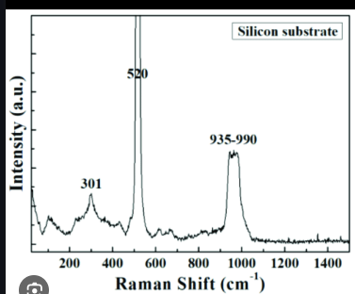
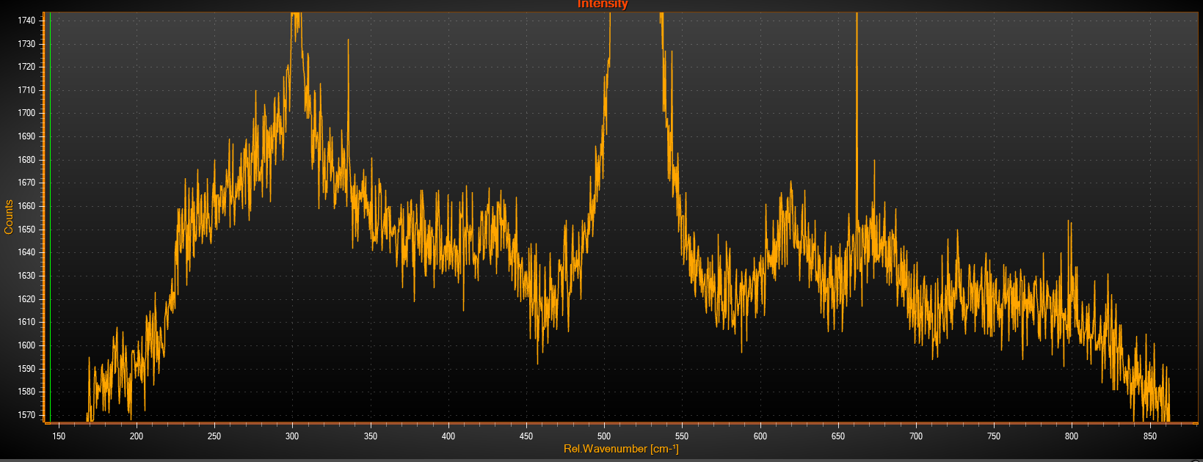
Power more than 2.5 mW, 50x1, focus, 0 90 90 polarization

Slide 36
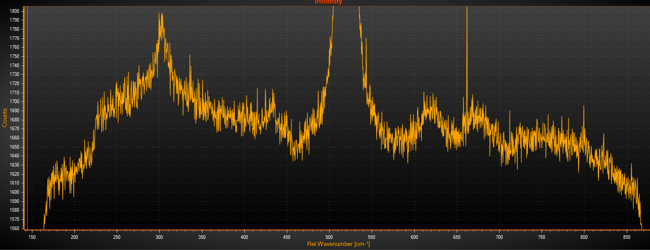
Power even more than 2.5 mW, 50x1, focus, 0 90 90 polarization

Slide 37
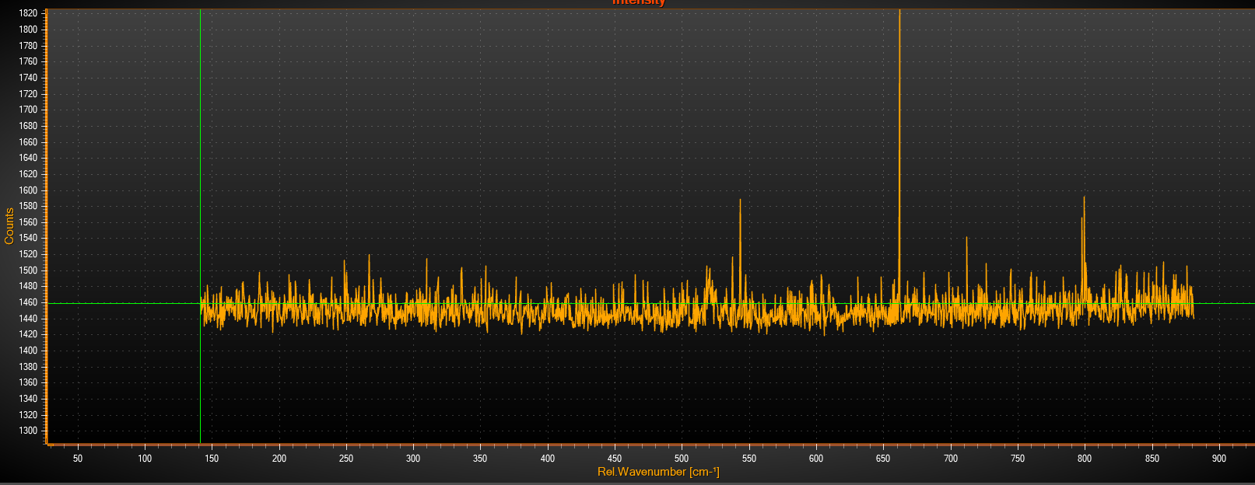
Power even more than 5 uW, 150x1, focus, 0 90 90 polarization

Slide 38
03.03.25

Slide 39
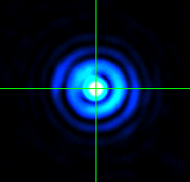
To check the focus, move slightly in z

Slide 40
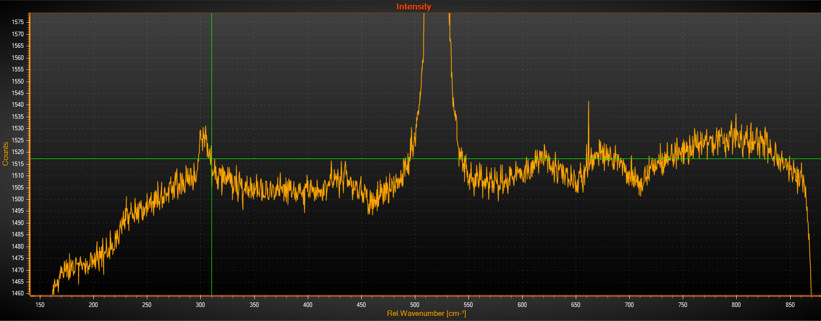
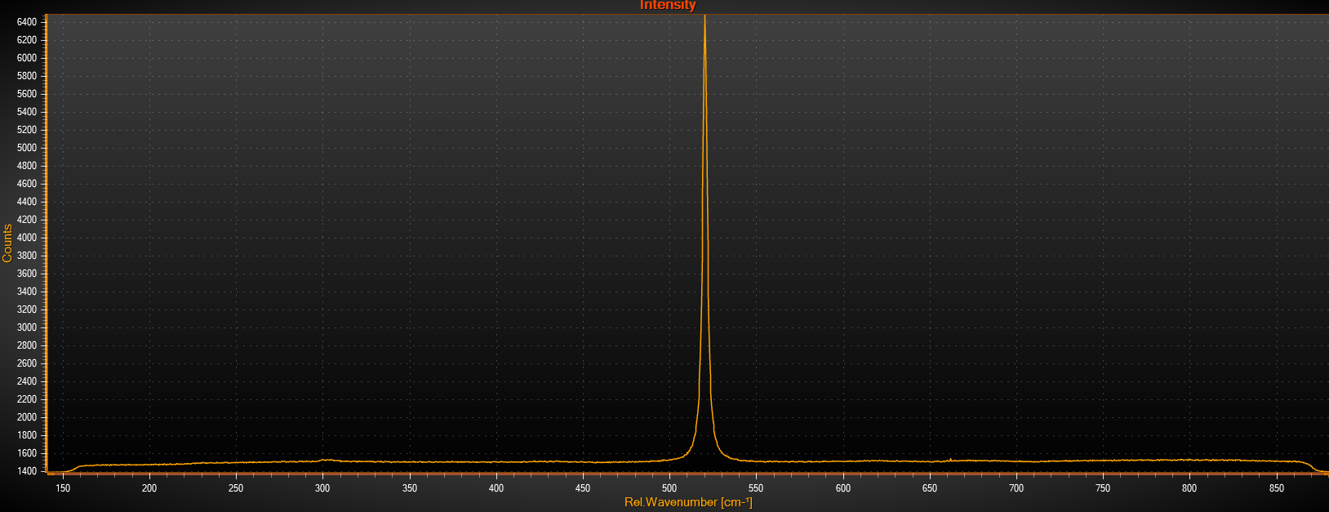
1. aquire silicon spectrum
Its saved

Slide 41
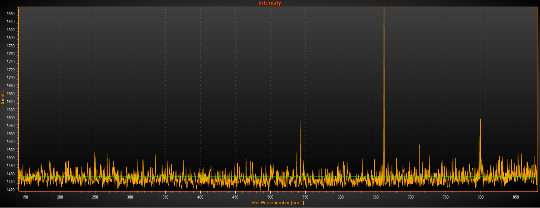
On suspended membrane 5 uW

Slide 42



On flake (1) 2.5 mW

Slide 43


On flake (2) 2.5 mW

Slide 44


On flake (3) 2.5 mW

Slide 45

On flake (4) 0.1 mW, exposure time 150x3

Slide 46

On flake (5) 1 mW, exposure time 50x3

Slide 47

Silicon (6) 1 mW, exposure time 50x3

Slide 48

On flake (7) 1 mW, exposure time 50x3

